Slide 1
Online Retail Sales: From Data Cleaning to Predictive Modelling
Prepared By:
Sina Ainesazi Dovom
Date:
21/07/2023

Slide 2
Content of the Presentation
Introduction
Brief on the Project Objective
Overview of the Data Used
Data Cleaning and Exploration
Description of Cleaning Process
Findings from the Exploration
Data Visualization
Explanation of Chosen Visualizations
Insights Gained from Visualizations
Predictive Modelling
Choice of Predictive Model
Assumptions and Model Validation
Model Performance Metrics
Insights and Recommendations
Detailed Insights from the Analysis
Actionable Recommendations for Sales Improvement
Conclusion
Summary of Key Findings
Impact of Recommendations
Final Thoughts and Future Work

Slide 3
Introduction

Slide 4


Introduction
Project Objective:
Conducted comprehensive analysis of the Online Retail dataset.
Identified patterns and insights through exploratory data analysis.
Created informative data visualizations to aid understanding.
Developed a predictive model for six-month sales forecasting.
Generated actionable insights and recommendations for potential sales performance enhancement.
Data Overview:
The dataset sourced from the UCI Machine Learning Repository comprises information regarding various retail transactions.
Variables include InvoiceNo, StockCode, Description, Quantity, InvoiceDate, UnitPrice, CustomerID, and Country.

Slide 5
Data Cleaning and Exploration

Slide 6
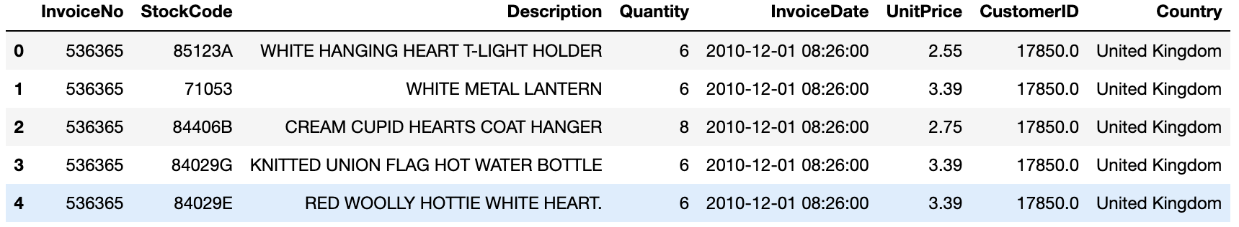
Variables
1. InvoiceNo: Invoice number. Nominal, a 6-digit integral number uniquely assigned to each transaction.
2. StockCode: Product (item) code. Nominal, a 5-digit integral number uniquely assigned to each distinct product.
3. Description: Product (item) name. Nominal.
4. Quantity: The quantities of each product (item) per transaction. Numeric.
5. InvoiceDate: Invoice Date and time. Numeric, the day and time when each transaction was generated.
6. UnitPrice: Unit price. Numeric, Product price per unit in sterling.
7. CustomerID: Customer number. Nominal, a 5-digit integral number uniquely assigned to each customer.
8. Country: Country name. Nominal, the name of the country where each customer resides.
Shape of the Dataset is:
(541909, 8)
We can notice that we will have to deal with time series data, integers and floats, and categorical, and text data.

Slide 7
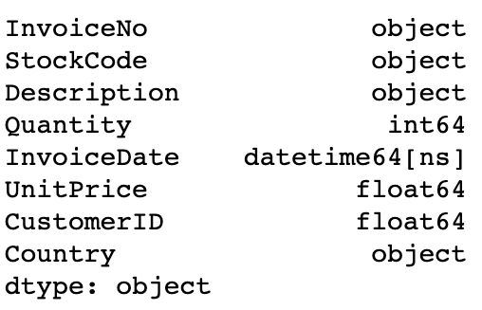
Types of the variables:
InvoiceNo variable seems to have not only
numbers, so we will find out interesting facts
ahead.
The InvoiceDate variable is of type datetime
Whenever this variable is not of this type, it should be converted
To datatime.

Slide 8
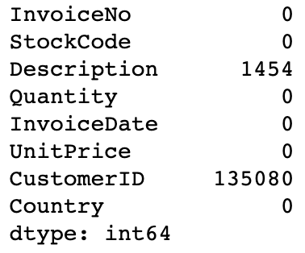
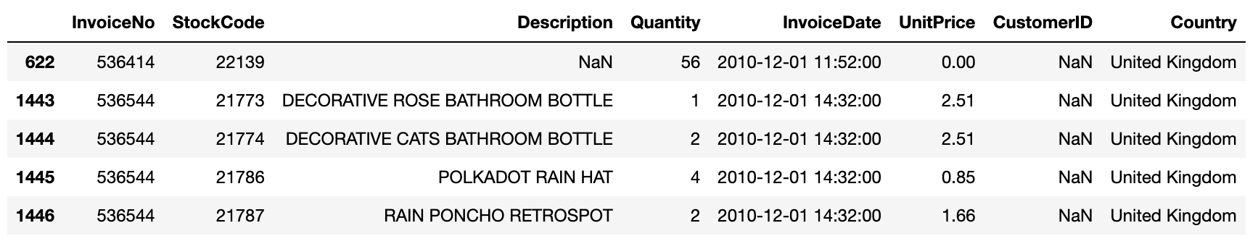
Checking for null values
We have null values only in Description and CustomerID variables.
Encountered substantial missing values in the 'CustomerID' variable.
No specific pattern observed from the rows with missing 'CustomerID'.
Due to the high volume of missing data, decided to drop 'CustomerID' from the analysis.

Slide 9
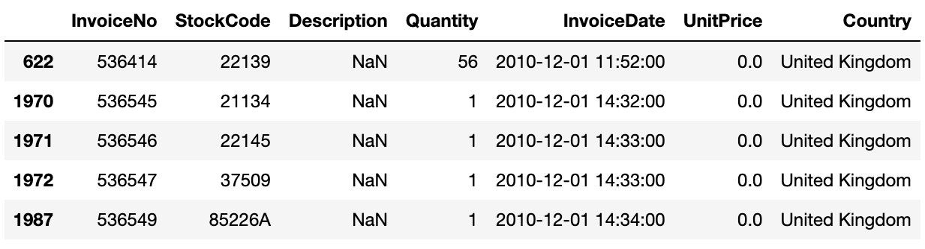
For the Description variable:
Identified a pattern where missing 'Description' corresponded with a 'UnitPrice' of 0.0.
This unusual scenario indicated that missing descriptions were likely tied to zero-cost items.
Filled in missing 'Description' values with 'UNKNOWN' to maintain data integrity.

Slide 10
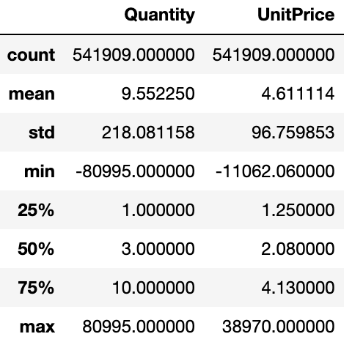
Quick summery statistics
This statistics shows a few interesting facts:
The majority of transactions are for quantities from 3 to 10 items
and the majority of items have prices up to 5.
The minimum values for both 'Quantity' and 'UnitPrice' are negative,
which is unusual.
It can be seen that the standard deviations for both variables are quite large,
suggesting a significant spread in the data. This, along with the massive gap
between the max and 75th percentile, indicates the presence of outliers.
We have a bunch of huge outliers we will have to deal with.

Slide 11
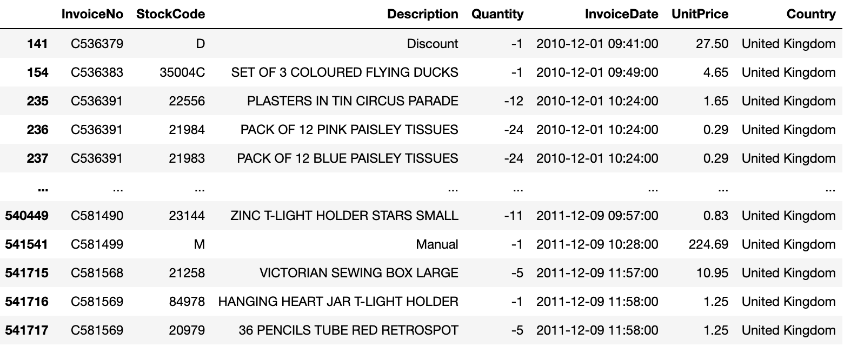
Finding out why do ‘Quantity’ and ‘UnitPrice’ variables contain negative values?
For Quantity:
Discovered an intriguing pattern where 'InvoiceNo' starts with a 'C' whenever 'Quantity' is a negative number.
This potentially indicates cancelled orders, leading to negative quantities in the dataset.

Slide 12
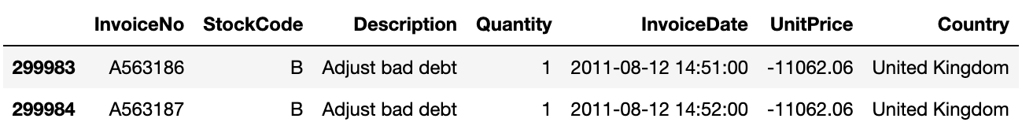
For UnitPrice:
Only 2 rows contain negative values for UnitPrice feature.
"Adjust bad debt" could mean that the company is recording a transaction to adjust for a bad debt. This might not be an actual sale but rather an accounting action. So, it can be seen the InvoiceNo starts with 'A', this might be the word 'Accounting’.

Slide 13
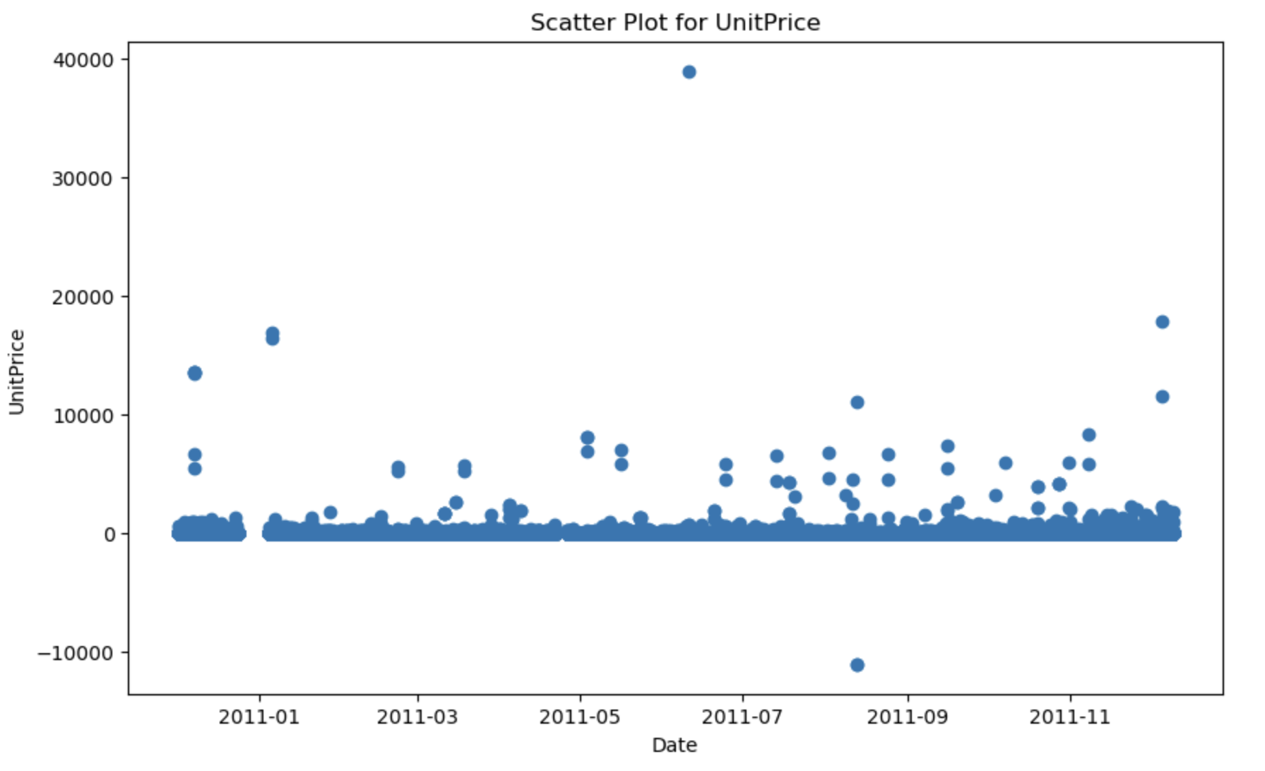
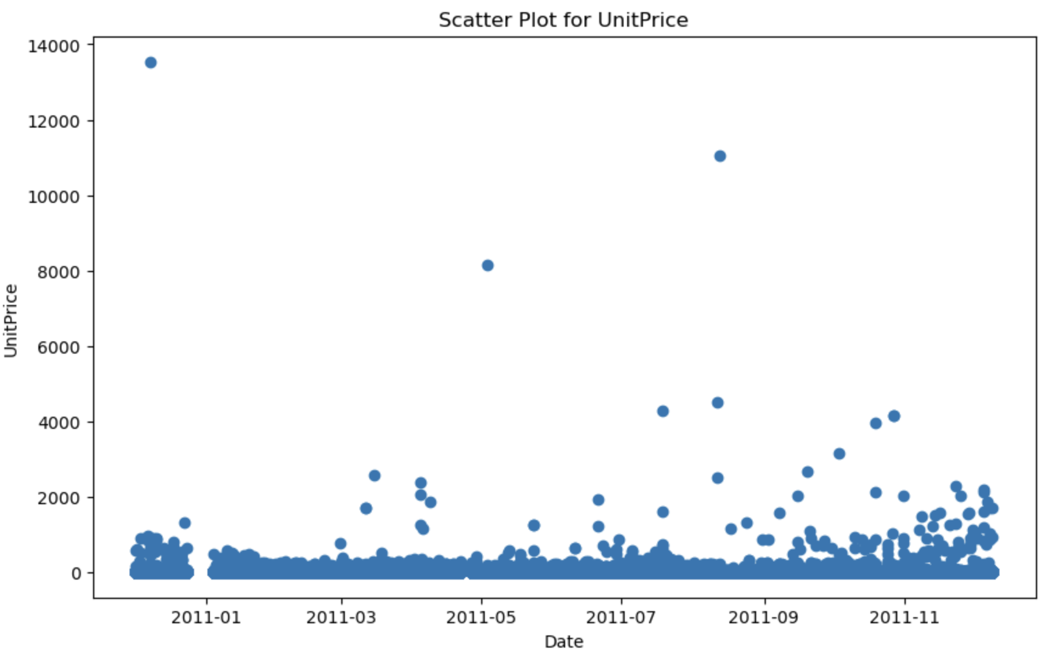
Outlier Detection
For UnitPrice:
Scatter plot reveals two key outliers in UnitPrice: one negative value and one
extremely high value close to 40,000.
Our analysis identified these as outliers and justified their removal to
maintain data integrity.
The remaining data, free from these extreme outliers, provides a more
reliable foundation for our subsequent analysis and model building.
The cleaned UnitPrice data range is now 0 to 20,000.
Again some outliers can be observed.
In the next slide, Let's take a look to see what are these outliers.

Slide 14
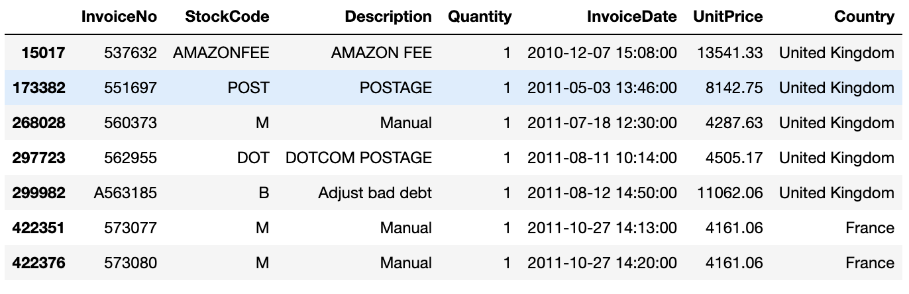
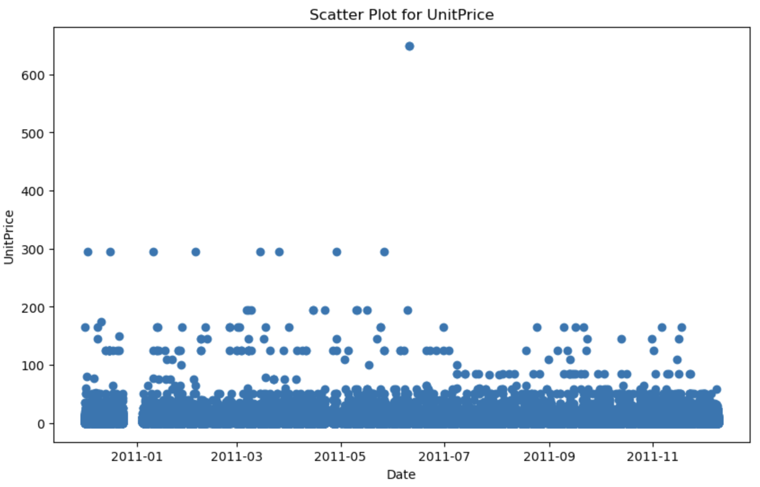
UnitPrice values in the range of 4K to 14K:
Identified outliers such as 'AMAZON FEE', 'POSTAGE’,
'Adjust bad debt', 'Manual', and 'DOTCOM POSTAGE'.
Based on our analysis objectives, these outliers do not contribute
meaningful information and were therefore removed to ensure
data quality.
Post-cleaning, observed an item with a notably high price, the
'PICNIC BASKET WICKER 60 PIECES', appearing in only two invoices
with differing quantities. As these outliers could distort our predictive
model, I decided to remove these instances to maintain model
robustness.

Slide 15
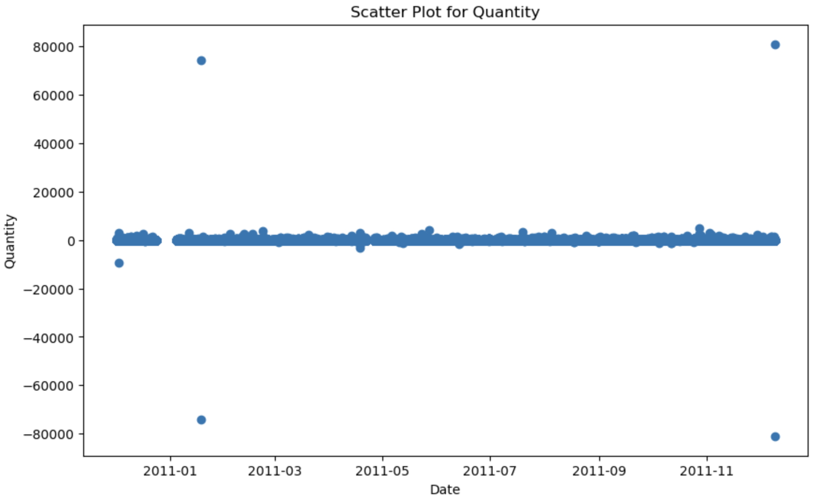
For Quantity:
This plot shows negative outliers for the Quantity
variable which we can guess the reason and also two
datapoints are extremely out of range which are close
to 80000, these also are outliers so we should
eliminate from the data. So, the negative values and values
greater than 20K were also removed for this variable.
Note: Actually, the negative values also could be a potential subject to go deep and
analyse these kind of Invoices but for this project, I decided to ignore those.
After eliminating the detected outliers for this variable, No strange transaction were
Observed. And all the remaining were valid transactions.

Slide 16
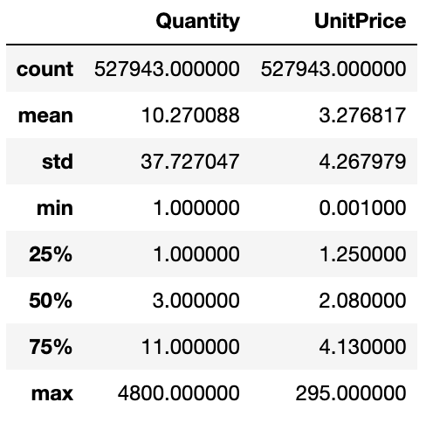
Checking the describe function again:
Now the data seem to be better.

Slide 17
Data Visualization

Slide 18
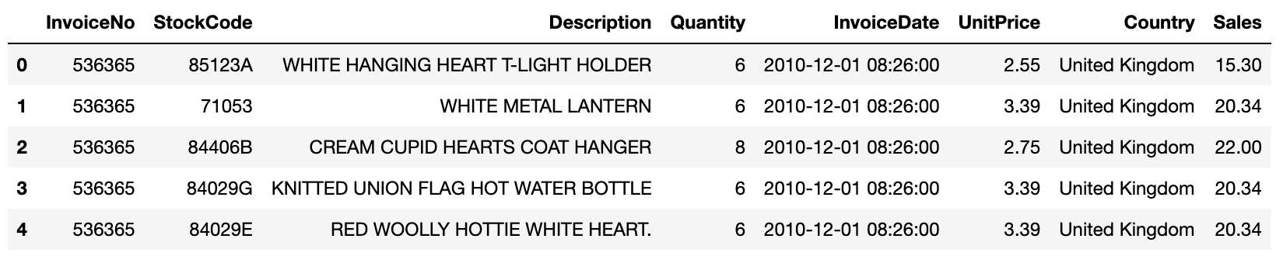
Creating new column
To understand better the data and finding valuable insights the column
‘Sales’ was created. The ’Quantity’ and ’UnitPrice’ were multiplied in each row.

Slide 19
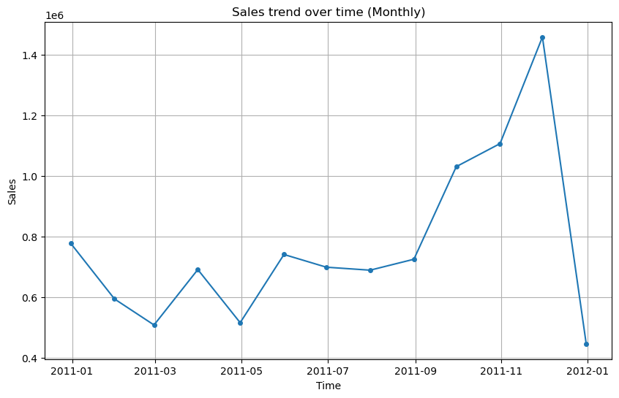
Sales trend over time on monthly basis

Slide 20
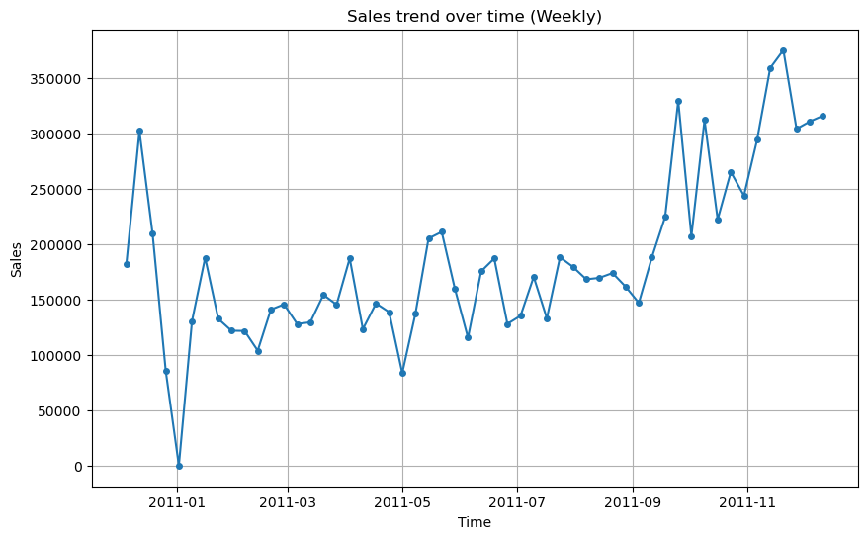
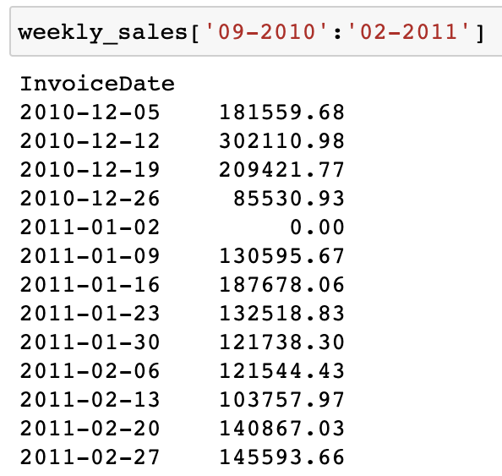
Sales trend over time on weekly basis
The sales is zero in 2011-01!
Maybe because of the new year the store was closed.

Slide 21
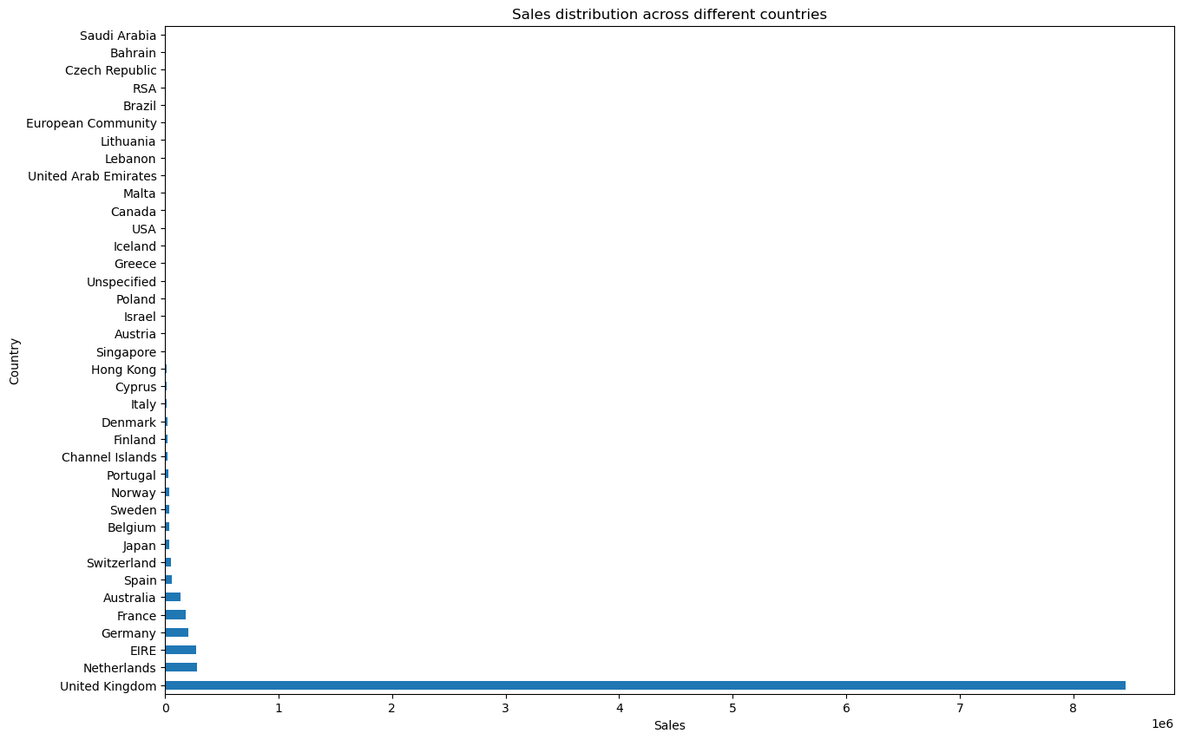
Sales distribution across different countries.
This plot shows that the majority of the Sales are related to the UK (around 91.69%).

Slide 22
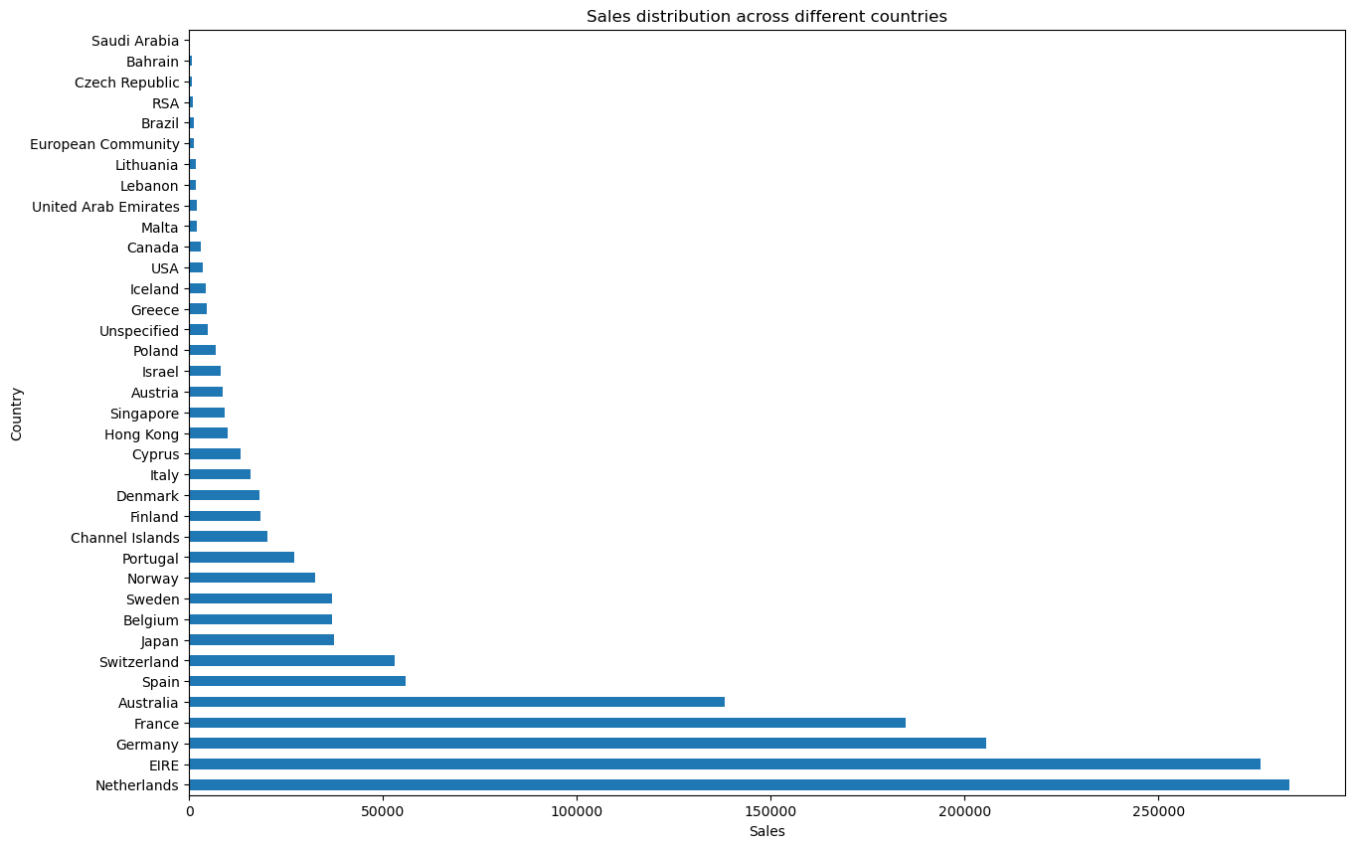
Sales distribution across different Non-UK countries.
After UK, the highest Sales are related to the Netherlands, Ireland, Germany, France and Australia respectively.

Slide 23
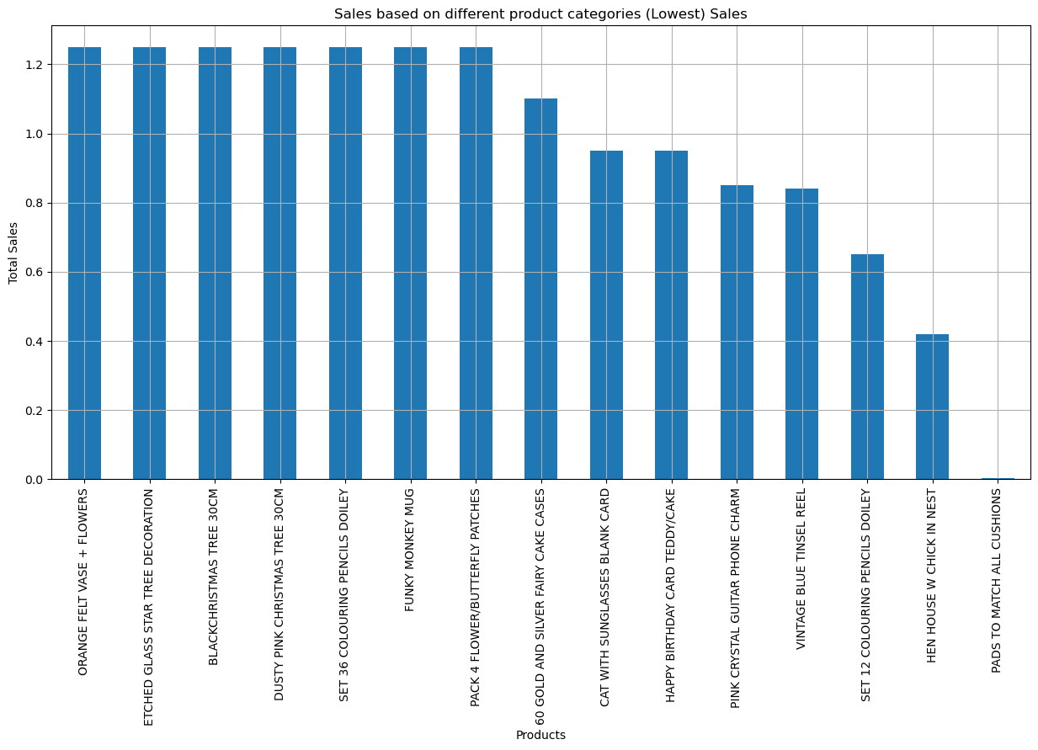
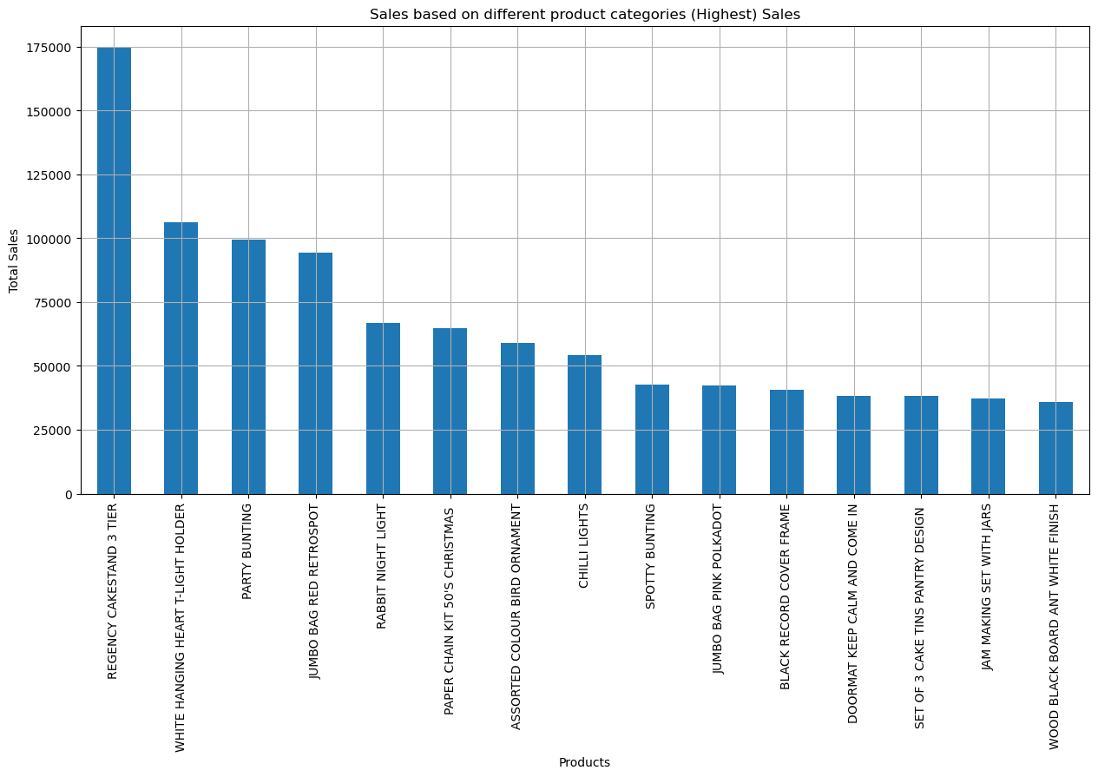
Sales based on different product categories
15 products with the lowest Sales:
Top 15 products with highest Sales:

Slide 24
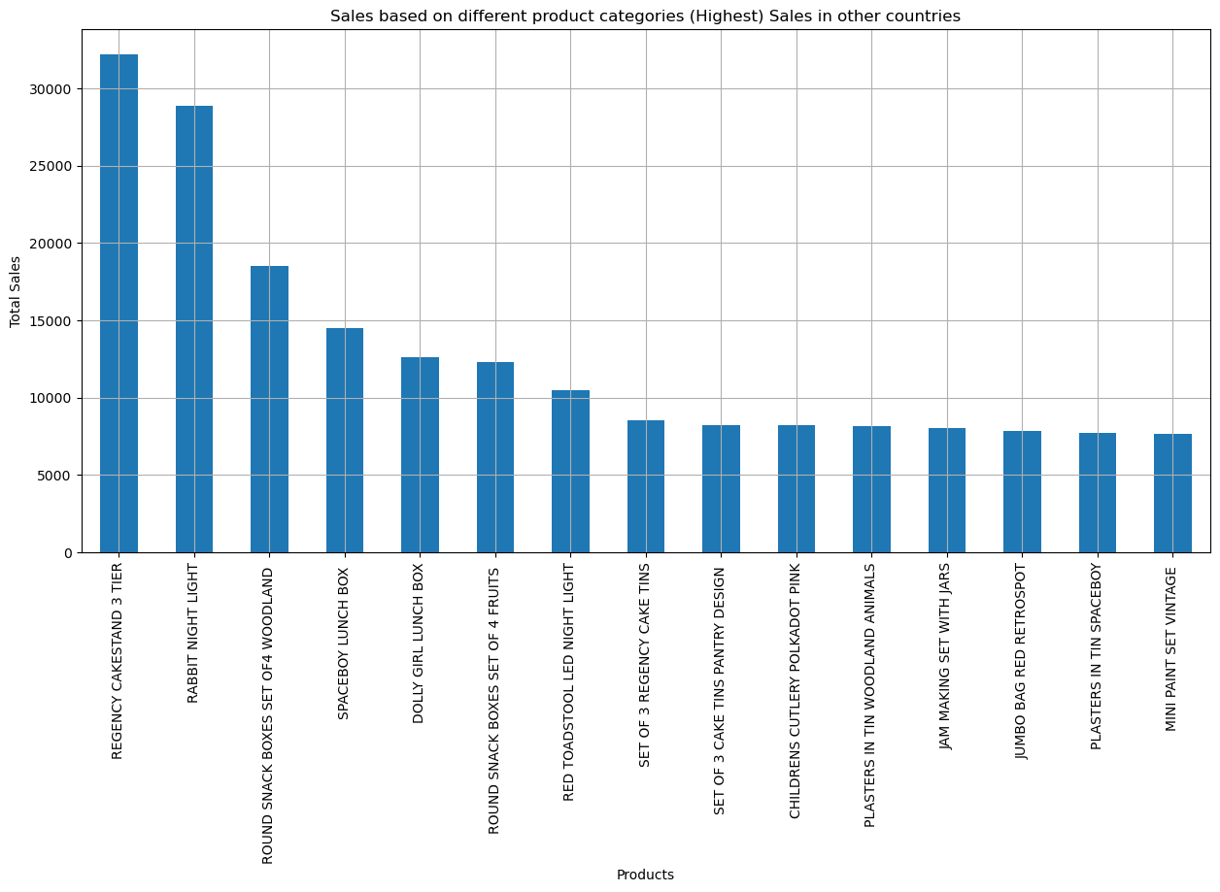
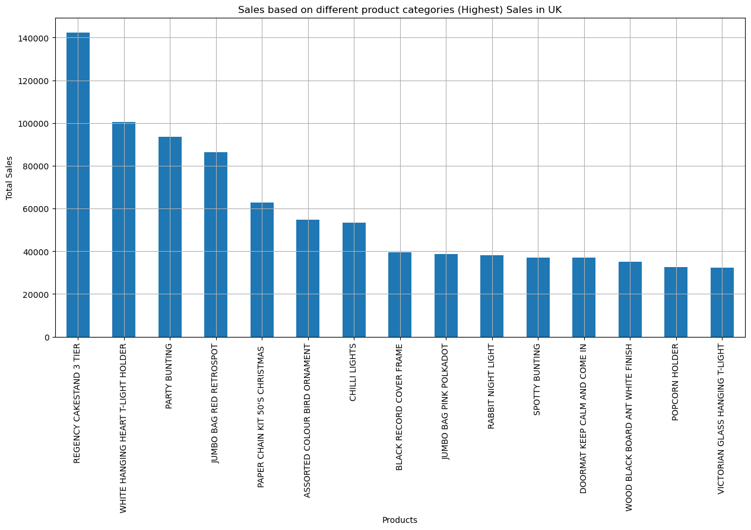
Products having the highest Sales in UK and Non-UK.
15 Products having the highest Sales in UK:
15 Products having the highest Sales in Non-UK:

Slide 25
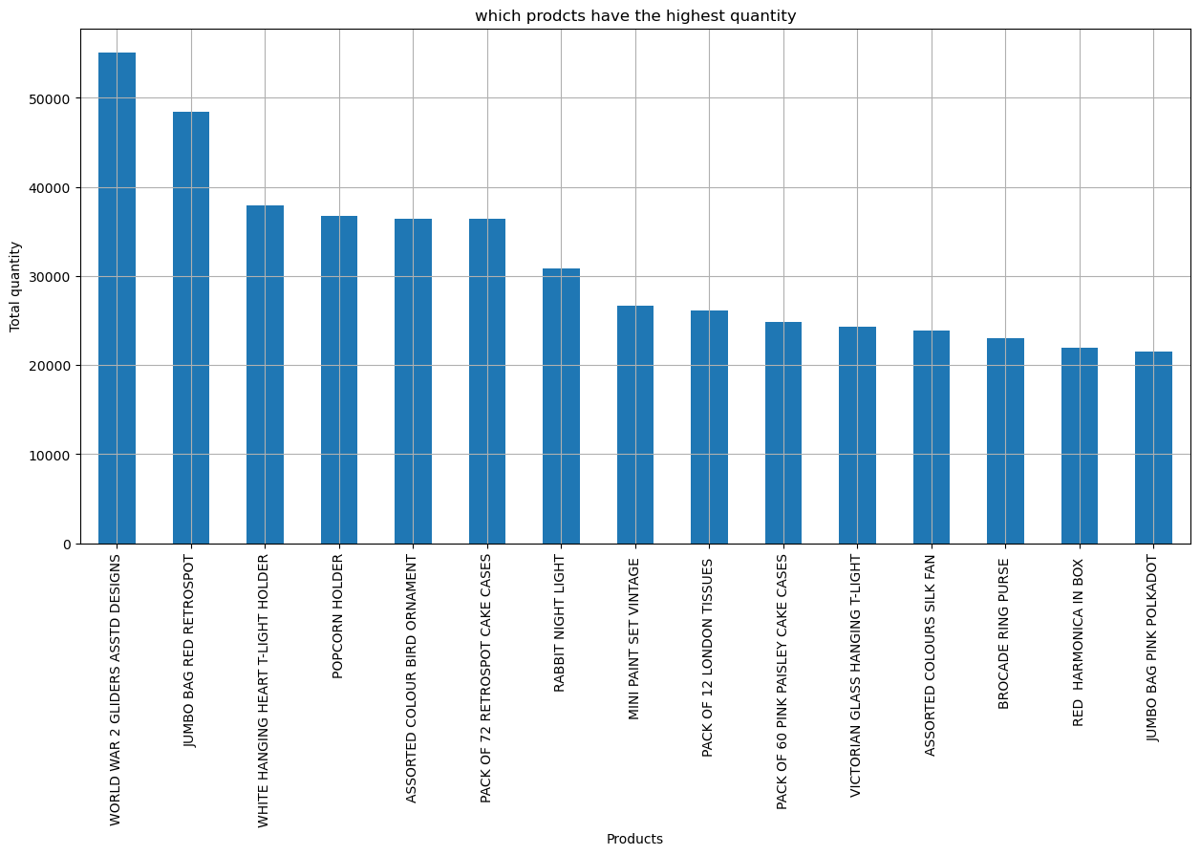
Products having the highest quantity in the Invoices

Slide 26
Predictive Modelling

Slide 27
Modelling approaches
Two modelling approaches have been done:
Product Sales over Time
UnitPrice Analysis over Time

Slide 28
Sales Predictive Modelling
Feature Engineering:
InvoiceDate: Extracting other useful features like year, month, day and hour and adding them to the features.
Applying encoding strategy on StockCode feature: Label Encoding: Using label encoding, where each StockCode is assigned a unique numeric identifier. This can be a good option for tree-based models, which can handle categorical features encoded in this way.

Slide 29
ML models used and the results
Three predictive models were evaluated:
Linear Regression,
Decision Tree,
Random Forest.
The models were trained on a feature set with 'Sales' as the target variable.
The feature set was scaled using StandardScaler for optimal performance.
Setting up a parameter grid for a GridSearchCV operation for all the models.
Linear Regression:
Best Score: 0.434
MAE: 9.58
MSE: 2246.33
R2 Score: 0.452
Decision Tree Regressor:
Best Score: 0.962
MAE: 0.29
MSE: 177.94
R2 Score: 0.957
Random Forest Regressor:
Best Score: 0.975
MAE: 0.18
MSE: 70.27
R2 Score: 0.983
Results:
Findings and Recommendations:
The Random Forest Regressor model performed the best out of the three models, with the highest Best Score and R2 score, and the lowest MAE and MSE.
Based on these results, I recommend using the Random Forest model for predicting 'Sales' in future analyses.

Slide 30
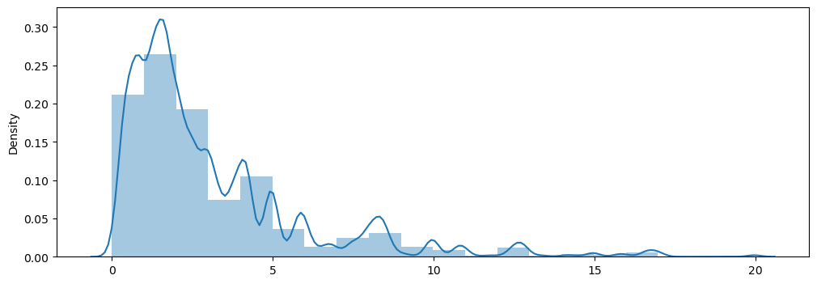
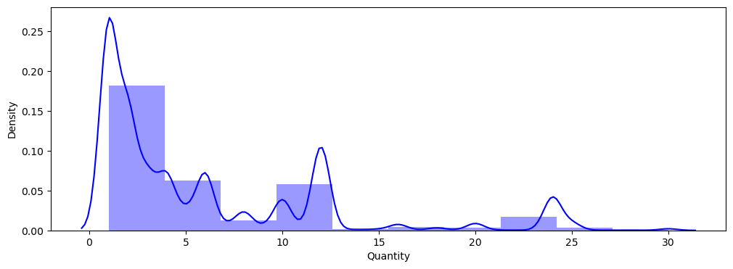
UnitPrice Predictive Modelling
Feature Engineering:
InvoiceDate: Extracted month as another useful features and added to the features.
Created a new feature, Quantity per invoice. The column contains the total number of items in each invoice.
Using the pandas.cut() method I grouped the Quantity and UnitPrice features into 6 and 5 groups respectively. (Bucketing)
Bucketing the Month variable for each 3 months.
The QuantityRange, PriceRange and DateRange columns were created and then dummy variables were created using them.

Slide 31
ML models used and the results
Three predictive models were evaluated:
Linear Regression,
Decision Tree,
Random Forest.
The models were trained on a feature set with UnitPrice' as the target variable.
Setting up a parameter grid for a GridSearchCV operation for all the models.
Linear Regression:
Best Score: 0.6246
Mean Absolute Error (MAE): 0.9224
Mean Squared Error (MSE): 9.1085
R2 Score: 0.5687
Decision Tree Regressor:
Best Score: 0.5958
Mean Absolute Error (MAE): 0.83
Mean Squared Error (MSE): 7.6751
R2 Score: 0.6366
Random Forest Regressor:
Best Score: 0.6431
Mean Absolute Error (MAE): 0.8251
Mean Squared Error (MSE): 7.4171
R2 Score: 0.6488
Results:
Model Comparison and Conclusion:
The Random Forest Regressor shows the highest Best Score and R2 Score, making it the most effective model for UnitPrice prediction.
However, the differences between the models are not drastic, suggesting further optimization might be beneficial.
Future steps could include exploring additional models or feature engineering techniques to improve predictions.

Slide 32
Time-Series Forecasting

Slide 33
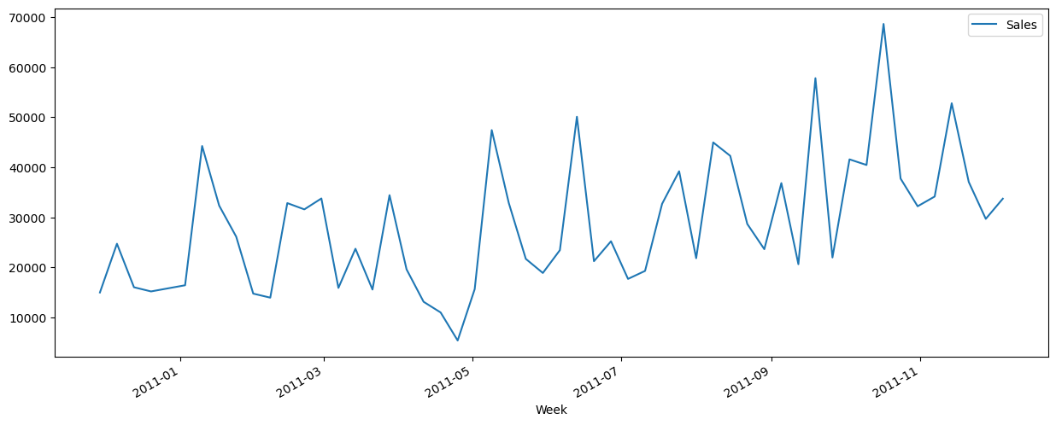
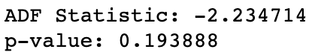
Sales Forecasting Using ARIMA Model on Non-UK dataset
We employed the ARIMA model to forecast future weekly sales of non-UK transactions. We started by transforming our data into a weekly time series and then tested for stationarity.
We applied the Augmented Dickey-Fuller Test to check the stationarity of our time series data. The p-value of 0.19 implies that we cannot reject the null hypothesis of a unit root, meaning our series is non-stationary. To make it stationary, we applied differencing.

Slide 34
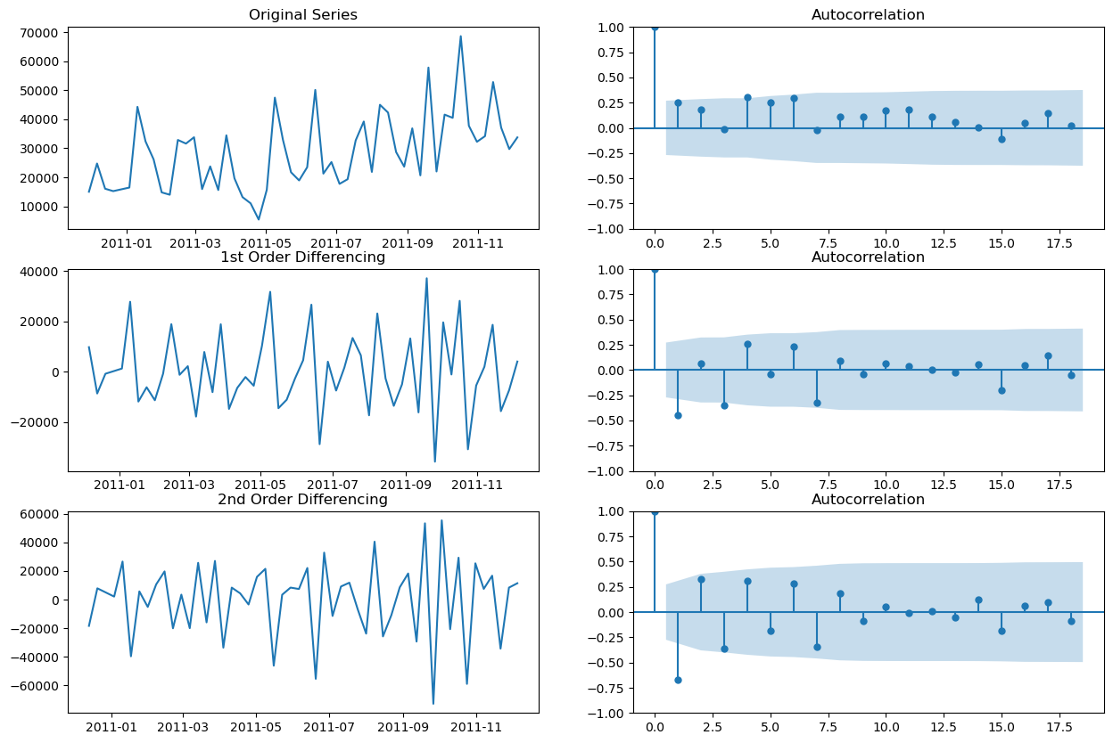
Sales Forecasting Using ARIMA Model on Non-UK dataset
First and second differencing was applied.
This series is almost stationary itself but however there's a
slow trend can be observed and also we can see from the
adfuller test that the P-value is larger than 0.05 and it needs
differencing of 1. and by applying one differing the series become stationary.

Slide 35
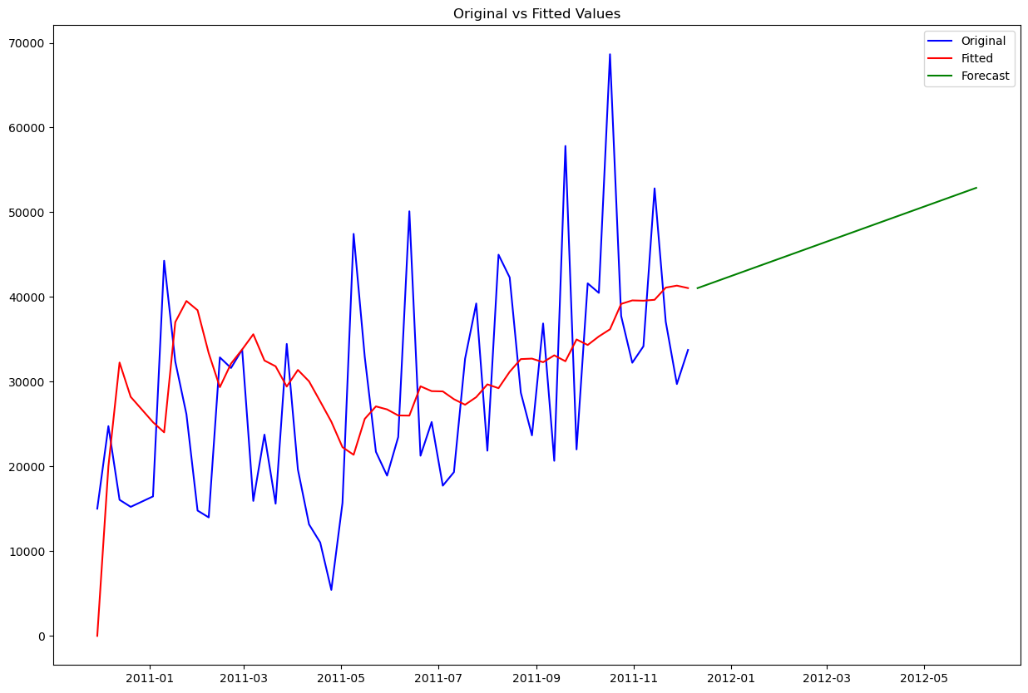
Sales Forecasting Using ARIMA Model on Non-UK dataset
ARIMA Model Selection:
Performed a grid search over various combinations of p, d, and q parameters for the ARIMA model, selecting the combination with the lowest BIC and AIC.
Results: The best ARIMA model is ARIMA(0, 2, 2) with BIC=1124.34 and AIC=1118.54.
Model Fit and Forecast:
The ARIMA(0, 2, 2) model fitted to the entire
data set and forecasted the next 26 weeks of sales.

Slide 36
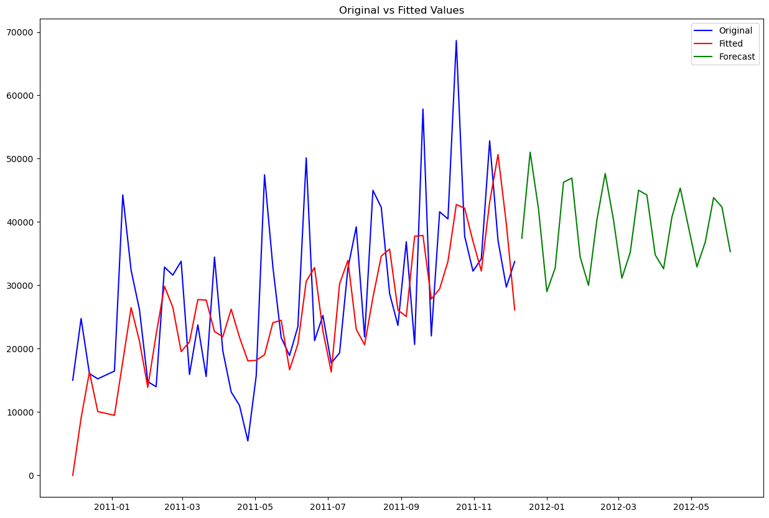
ARIMA Model Performance Evaluation
Also other ARIMA models with different orders manually the ARIMA(3,1,3) model evaluated and compared its performance to the ARIMA(0,2,2) model.
Results:
Model Summary of ARIMA(3,1,3) and performance metrics for both models on training and testing sets.
ARIMA(3,1,3): MAE: 10330.256 RMSE: 13163.232 MAPE: 28.145
ARIMA(0,2,2): MAE: 10417.951 RMSE: 13441.392 MAPE: 27.030
Conclusion:
While that the MAE and RMSE of the models are similar
The ARIMA(0,2,2) has fewer parameters and visually
Checking the fit and forecast of this model it could be
Observed that this model can not capture the behaviour
Of the weekly series and in this case the ARIMA(3,1,3)
Is having better results. But MAPE for ARIMA(0,2,2) is
lower.

Slide 37
Insights and Recommendations

Slide 38
Product Sales in Various Regions: The UK accounts for approximately 92% of all sales. Other significant markets include the Netherlands, Ireland, Germany, France, and Australia. To further boost sales, the company should consider strengthening its marketing strategies in these areas.
Product Focus: The 'Regency cakestand 3 tier' is a top-performing product in both the UK and other countries. The company could consider running special promotions or deals on this product to encourage further sales. Additionally, understanding why this product is so popular could help in the development of future products.
Sales Fluctuations: There are noticeable fluctuations in the weekly sales data, with sales dipping to zero in early 2011, likely due to the store closure. The company may want to consider alternative strategies during these periods, such as online sales or pre-holiday promotions.
Addressing Negative Values and Outliers: There are negative values and outliers in both 'Quantity' and 'UnitPrice' data that may distort the analysis. These anomalies may be a result of transactions being cancelled or due to bad debts. It's recommended to investigate these anomalies further to understand their root cause and take appropriate action to minimize their occurrence in the future.
Price Analysis Over Time: The analysis reveals a trend in unit prices over time. This insight can be used to predict future sales and develop pricing strategies. For example, the company might want to investigate the cause of price fluctuations to further optimize pricing.
Inventory Management: For example, ensuring that the top 15 products with the highest sales are always stocked can help increase the overall sales performance.
Product Variety: While focusing on top-performing products, it's also important not to ignore the lowest-selling products. Sometimes, it's the variety of products that attract more customers. Strategies can be developed to increase their sales, like bundling them with top-selling products.

Slide 39
Conclusion

Slide 40
Project Summary:
Our detailed analysis of online retail sales data revealed significant trends and patterns that can be used to optimize sales performance.
Key Findings:
Identified seasonal sales peaks, country-based sales concentration, varying product category performances.
Recommendations Recap:
Based on the findings, I recommended strategies such as intensifying seasonal marketing, investing more in high-performing product categories, enhancing customer loyalty programs.
Next Steps:
- Future work should focus on implementing these recommendations and monitoring their impact on sales. Further analysis could also be conducted to delve deeper into poorly performing product categories and strategies to boost sales in countries currently having low sales.
- And using other Time-Series models which may have better performance on this kind of series with strange behaviours through time.
The End

